Slide 1
Introduction to Marchantia
Ignacy Bonter
kb689@cam.ac.uk
University of Cambridge
Photography by Jim Haseloff and Ignacy Bonter

Slide 2
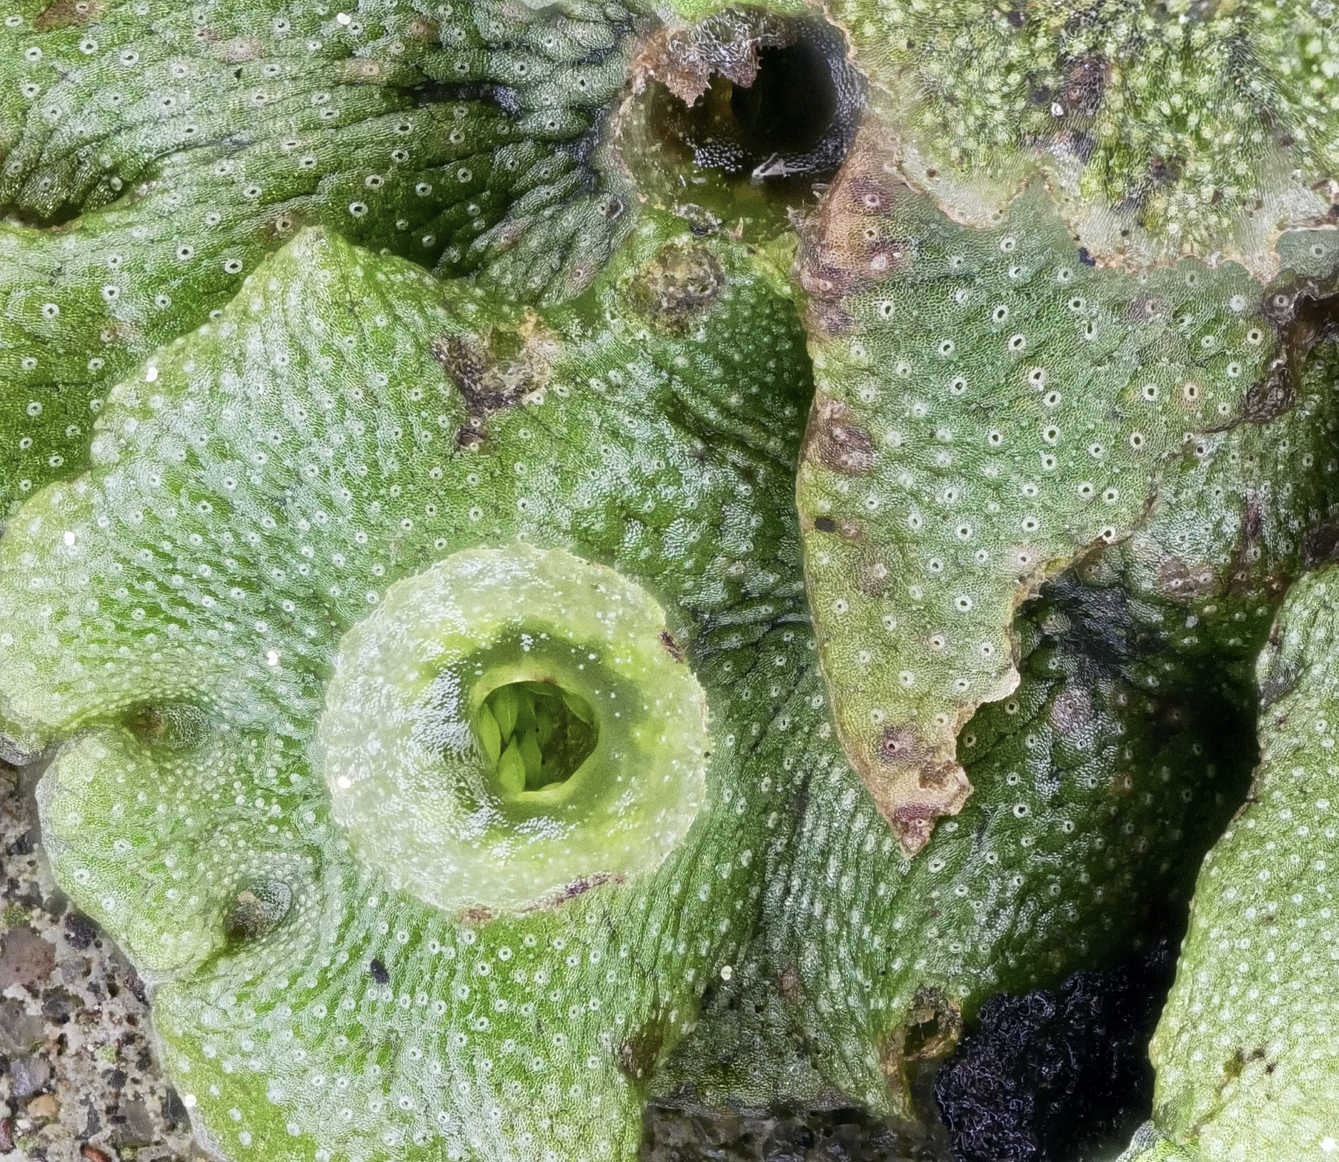
Marchantia polymorpha subsp. ruderalis
Thalloid liverwort
Haploid gametophyte is the dominant life stage
Complex 3D organization of tissues in dorso-ventrally polarized thallus
Dichotomously branching habit
Important to remember last common ancestor with flowering plants was more than 450 mya
Marchantia is not a basal land plant any more than Arabidopsis

Slide 3
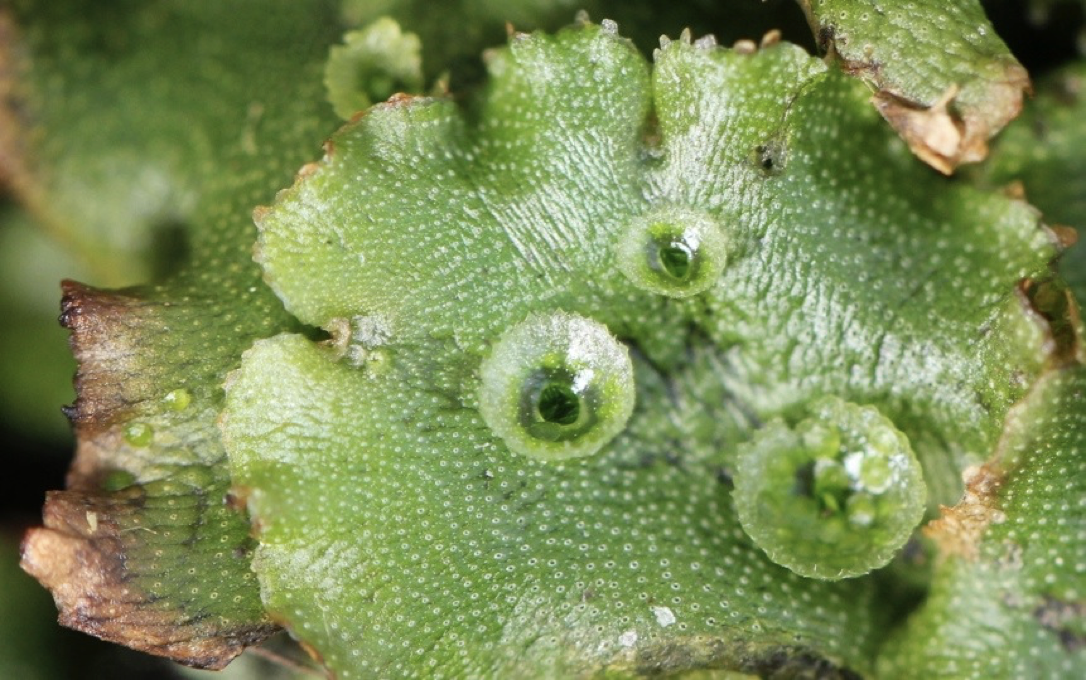
Marchantia polymorpha subsp. ruderalis – anatomy and morphology
Notch containing the meristem
Midrib tissue with scattered air chambers
Gemma cup
Dorsal surface covered in air chambers

Slide 4
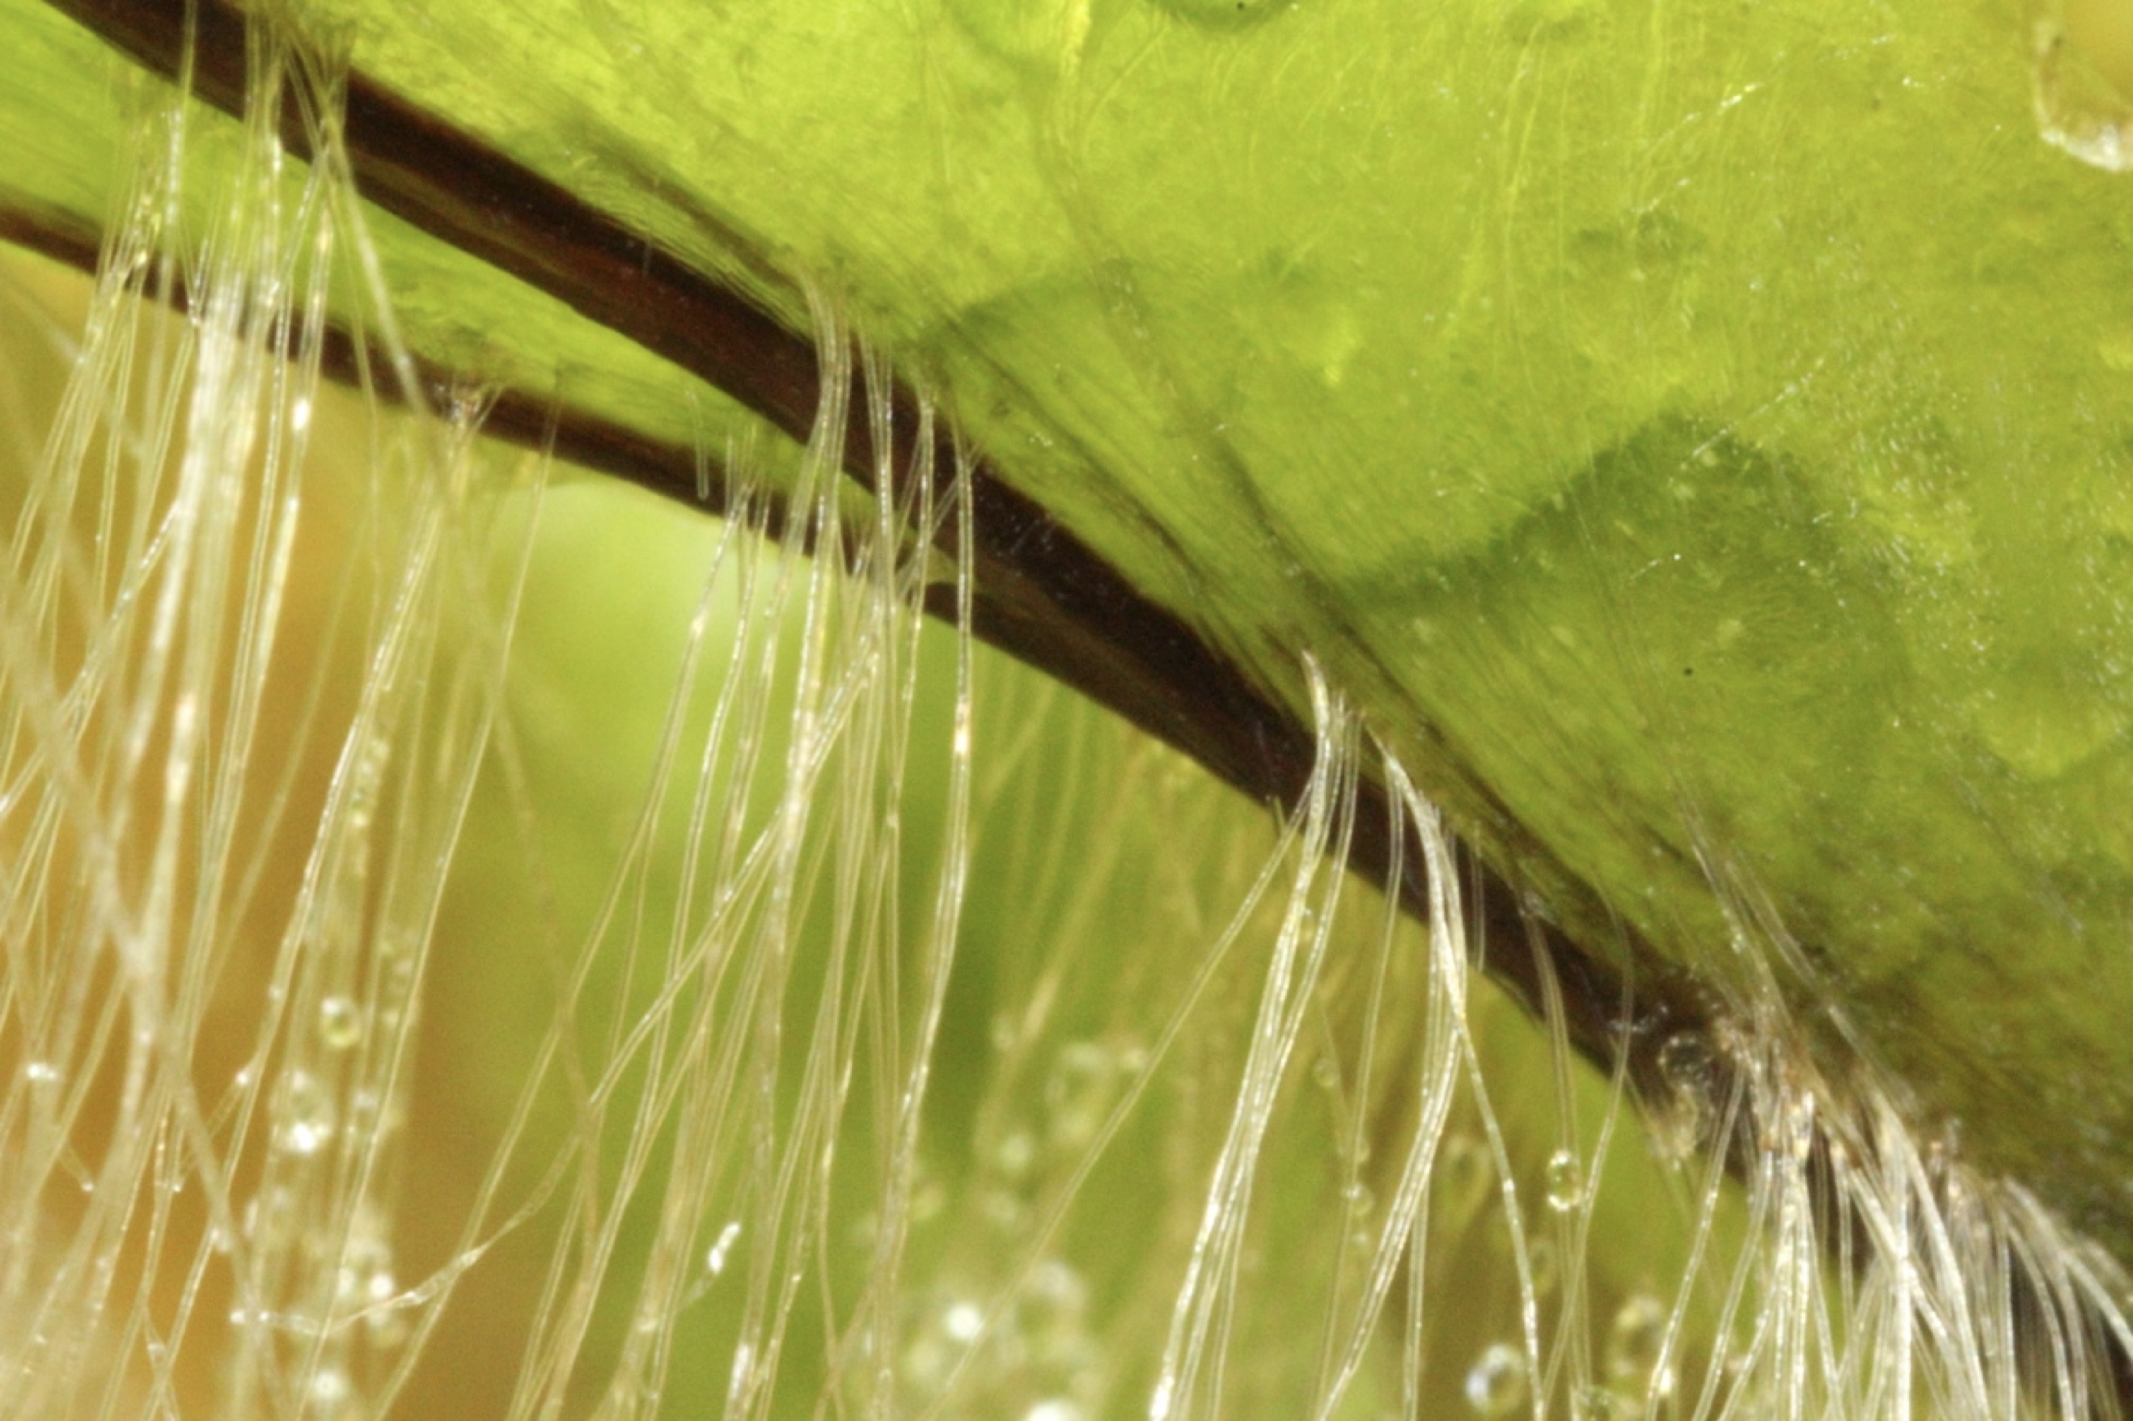
Marchantia polymorpha subsp. ruderalis – anatomy and morphology
Midrib containing pegged rhizoids
(single cell with modified cell wall)
Ventral surface covered in multicellular scales
(translucent or pigmented purple with auronidins
Smooth rhizoids
(single cell)

Slide 5
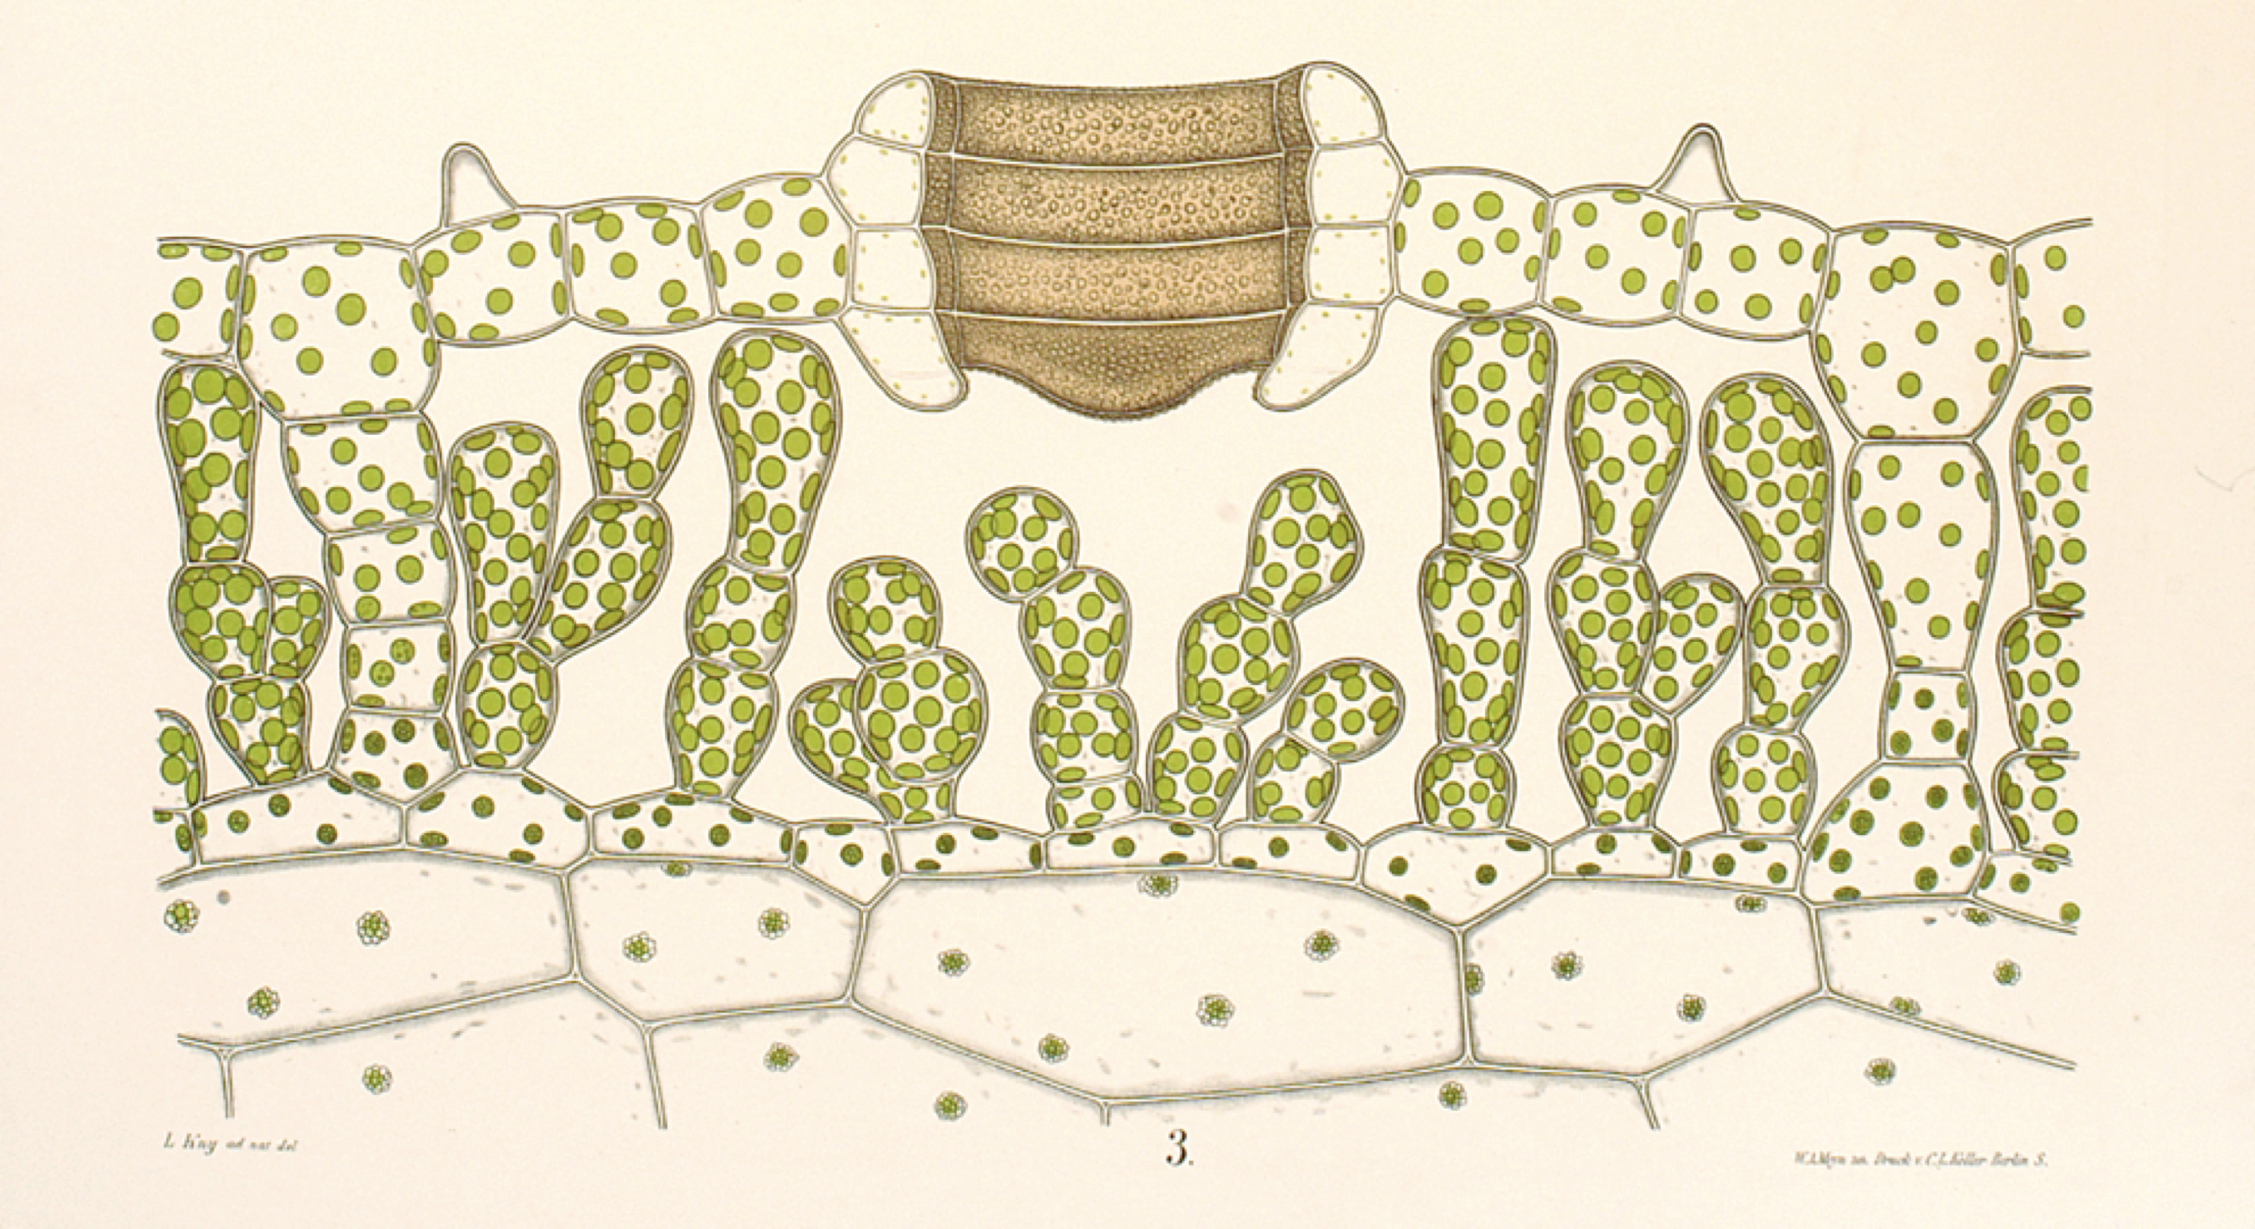
Marchantia polymorpha subsp. ruderalis – anatomy and morphology
Leopold Kny
Section through an air chamber

Slide 6
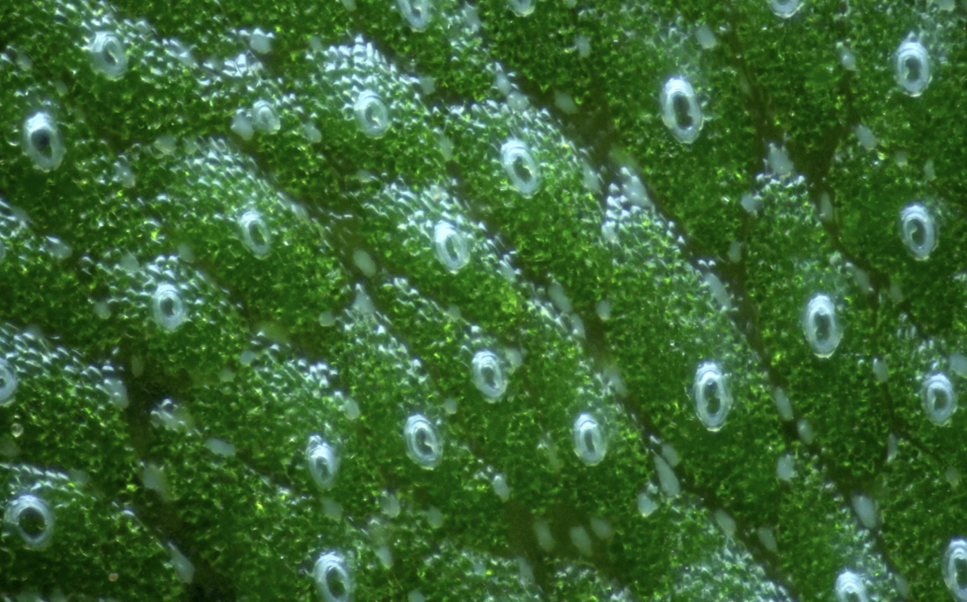
Marchantia polymorpha subsp. ruderalis – anatomy and morphology
Air chamber pore complex
Usually 16 (4x4) cells
No chloroplasts (small achlorophyllous plastids present)
Cannot open/close
High autofluorescence – important to keep in mind for confocal microscopy (easy to get false positives)
Multiple air chambers on the surface

Slide 7
Marchantia polymorpha subsp. ruderalis – anatomy and morphology
Oil body cells
Multiple air chambers on the surface

Slide 8
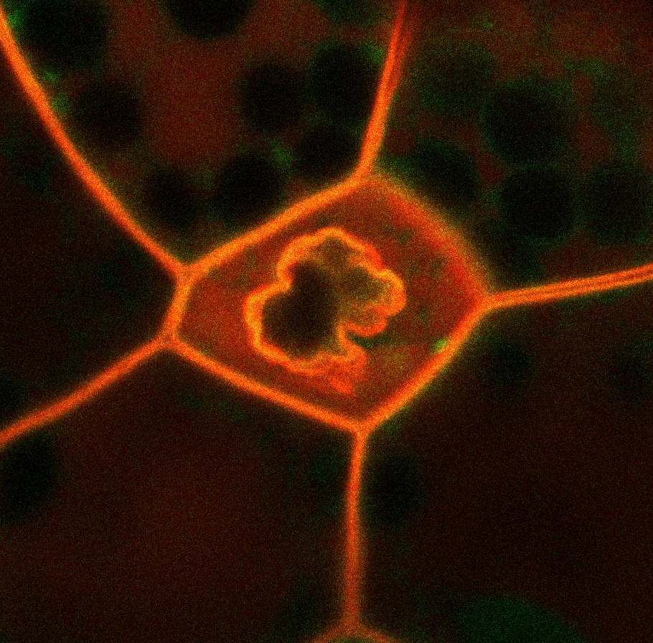
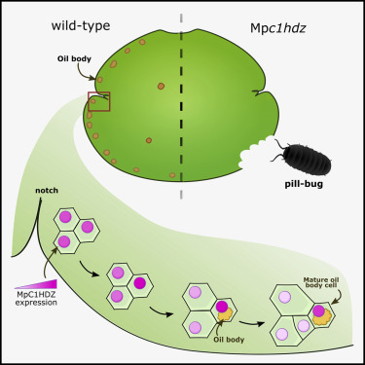
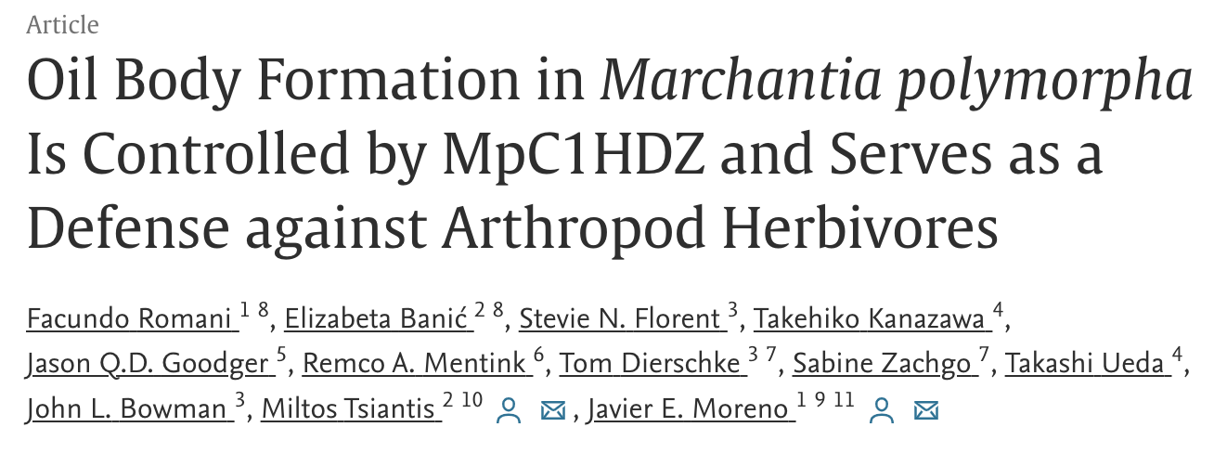
Oil bodies
Oil bodies are liverwort specific organelles
In Marchantia one oil body is present in a specialized oil body cell
Other liverworts usually have multiple oil bodies per cell in every cell
Oil bodies contain terpenoids and their main function is probably deterrence of herbivores
_{pro}UbE2:Lti6b-mScarlet -> cell membrane marker

Slide 9
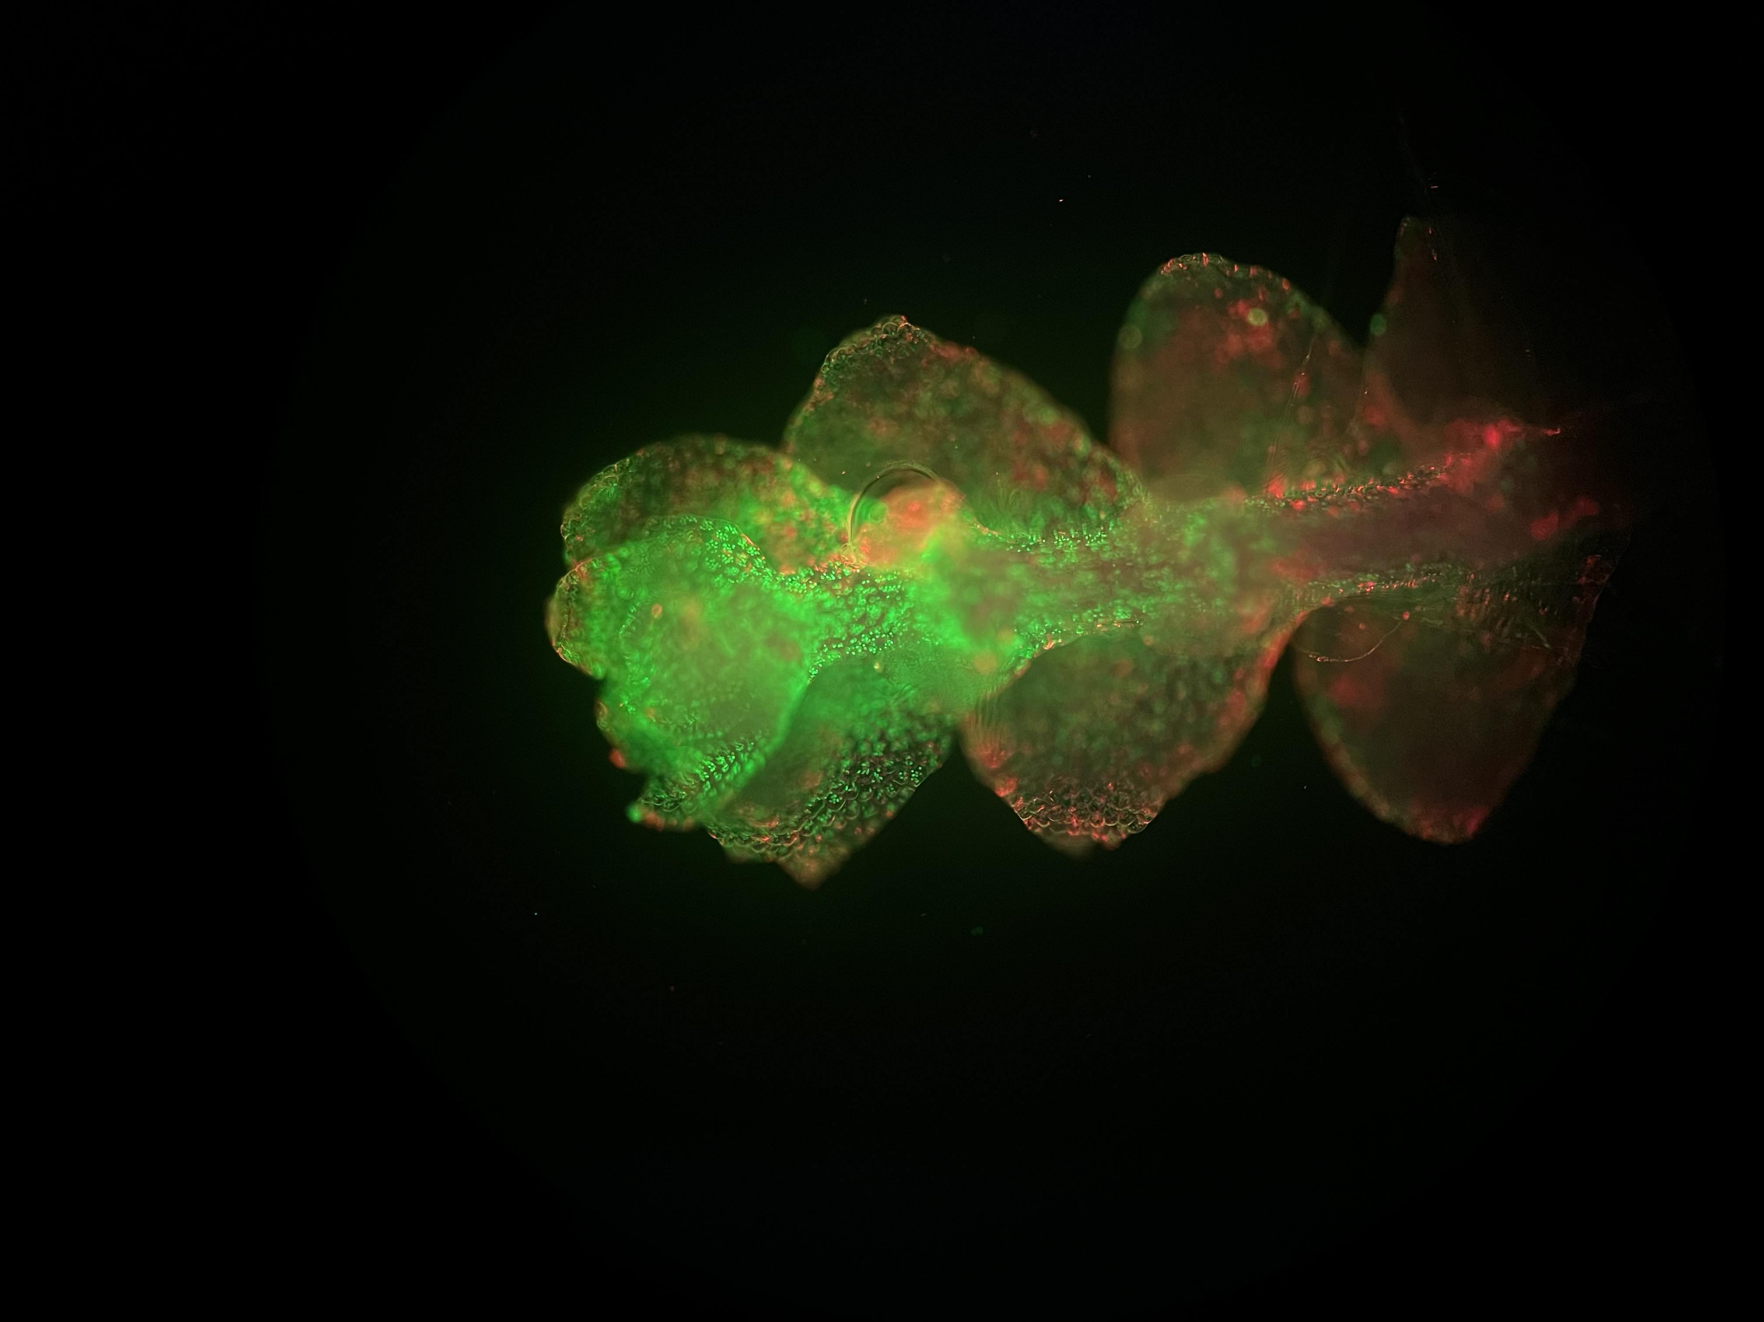
Calypogeia sp. Oil bodies stained with Bodipy in green
Chlorophyll autofluorescence in red
This species contains multiple oil bodies per cell

Slide 10
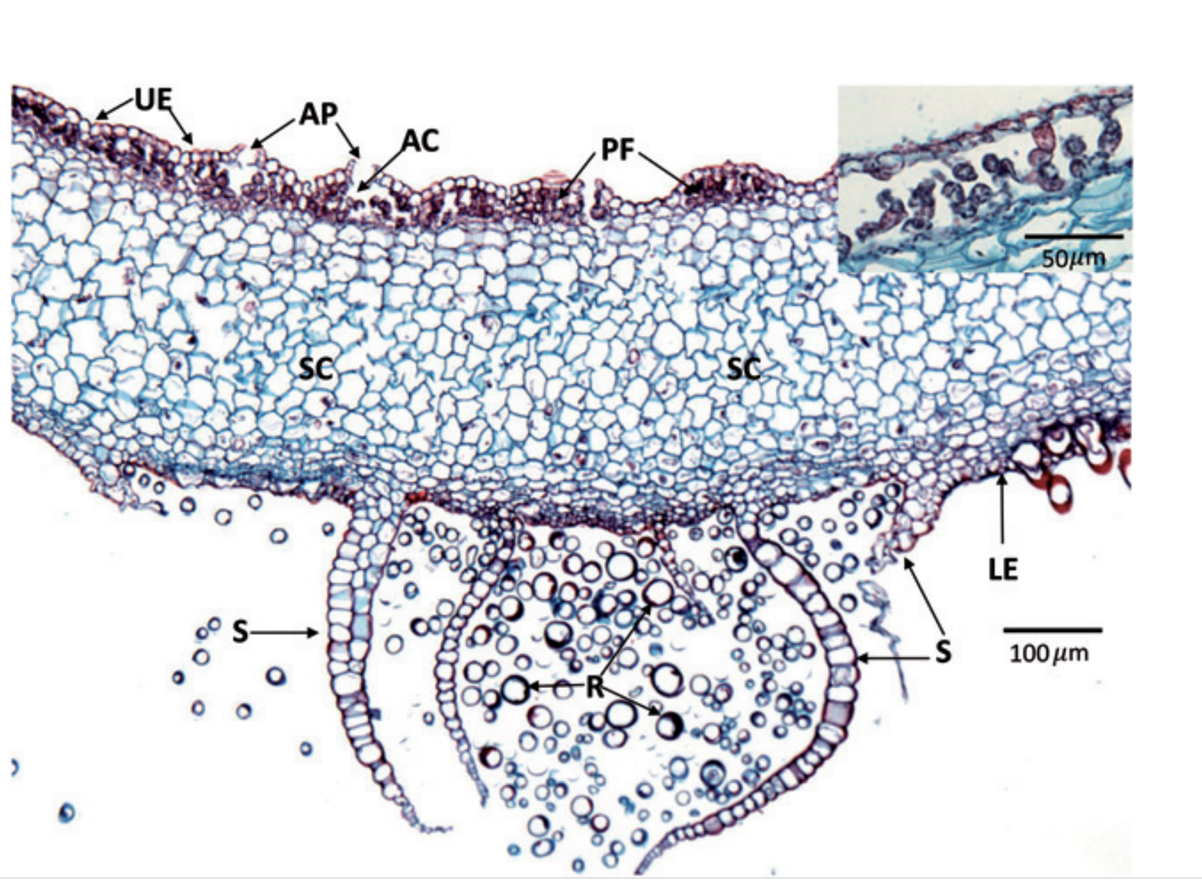
Marchantia polymorpha subsp. ruderalis – anatomy and morphology
Chlorenchyma constitutes a small percentage of the thallus biomass
Parenchyma cells are bigger, contain starch and lack developed chloroplasts
Jessica M. Budke, Ernest C. Bernard, Dennis J. Gray, Sanna Huttunen, Birgit Piechulla & Robert N. Trigiano (2018) Introduction to the Special Issue on Bryophytes, Critical Reviews in Plant Sciences, 37:2-3, 102-112, DOI: 10.1080/07352689.2018.1

Slide 11
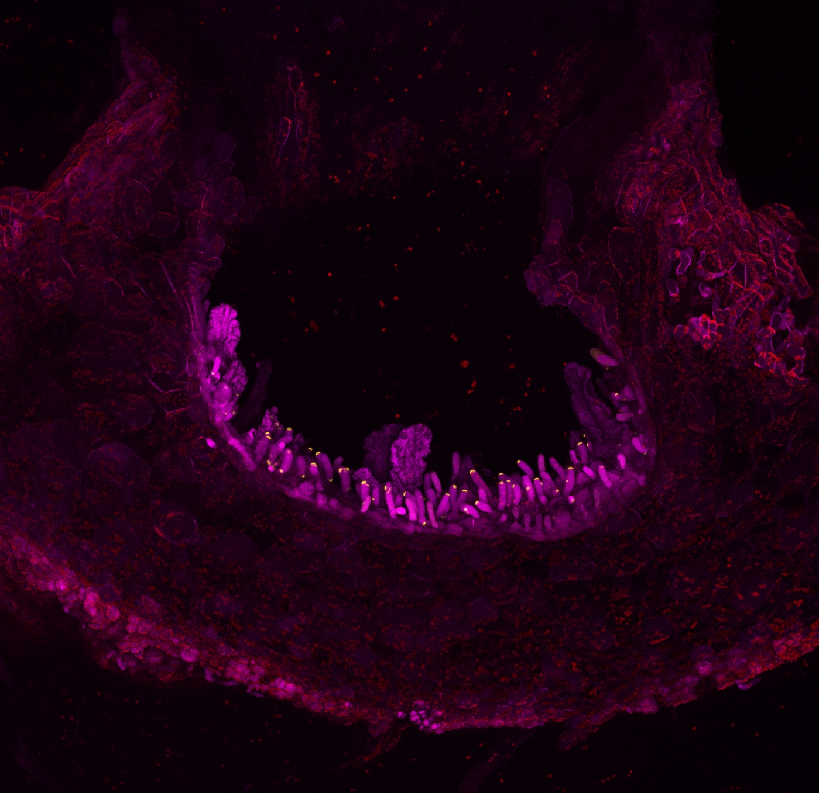
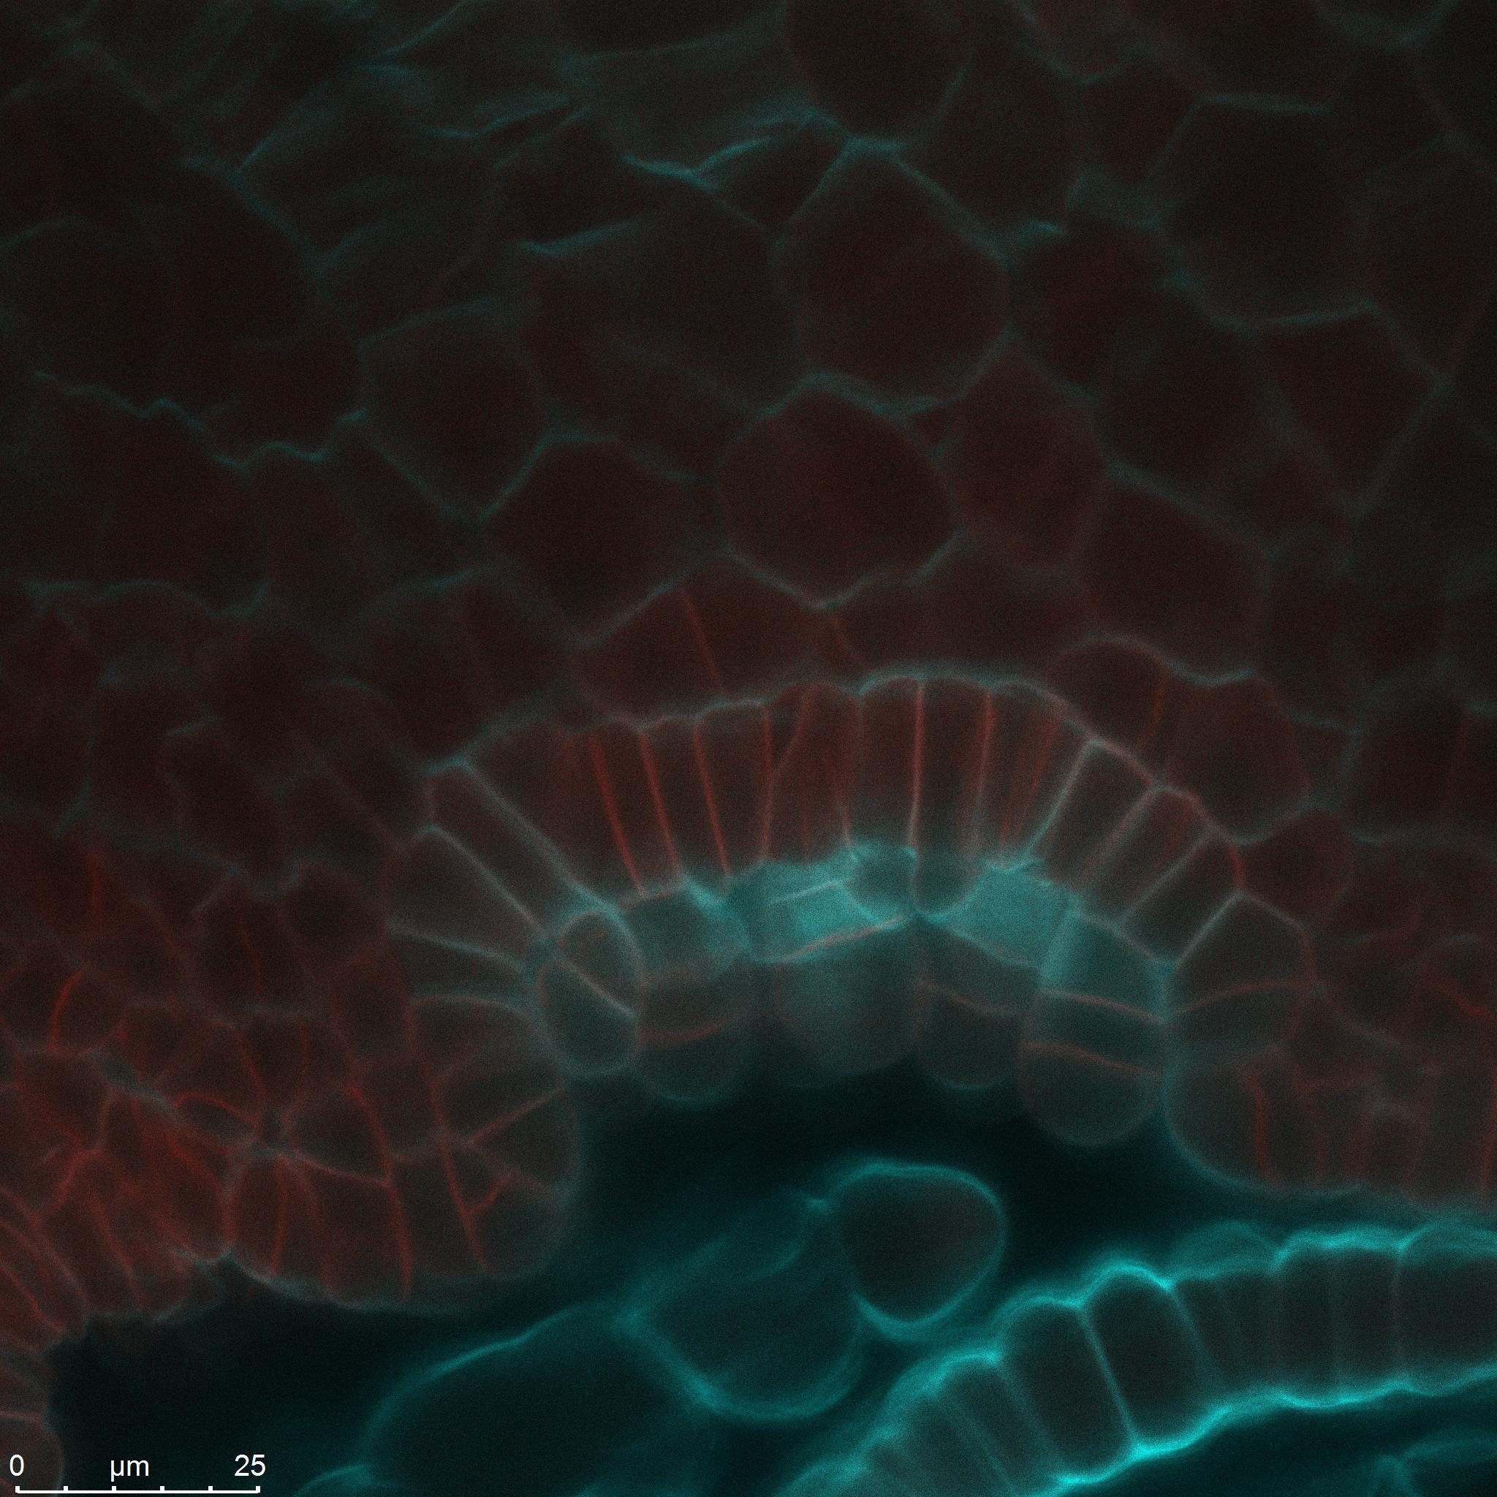
Marchantia polymorpha subsp. ruderalis – anatomy and morphology
Cross section through the mature cup
Cross section through the cup primordium
Membrane marker in red
Autofluorescence in magenta
Membrane marker in red
Cell wall stain in cyan
Developing gemmae

Slide 12
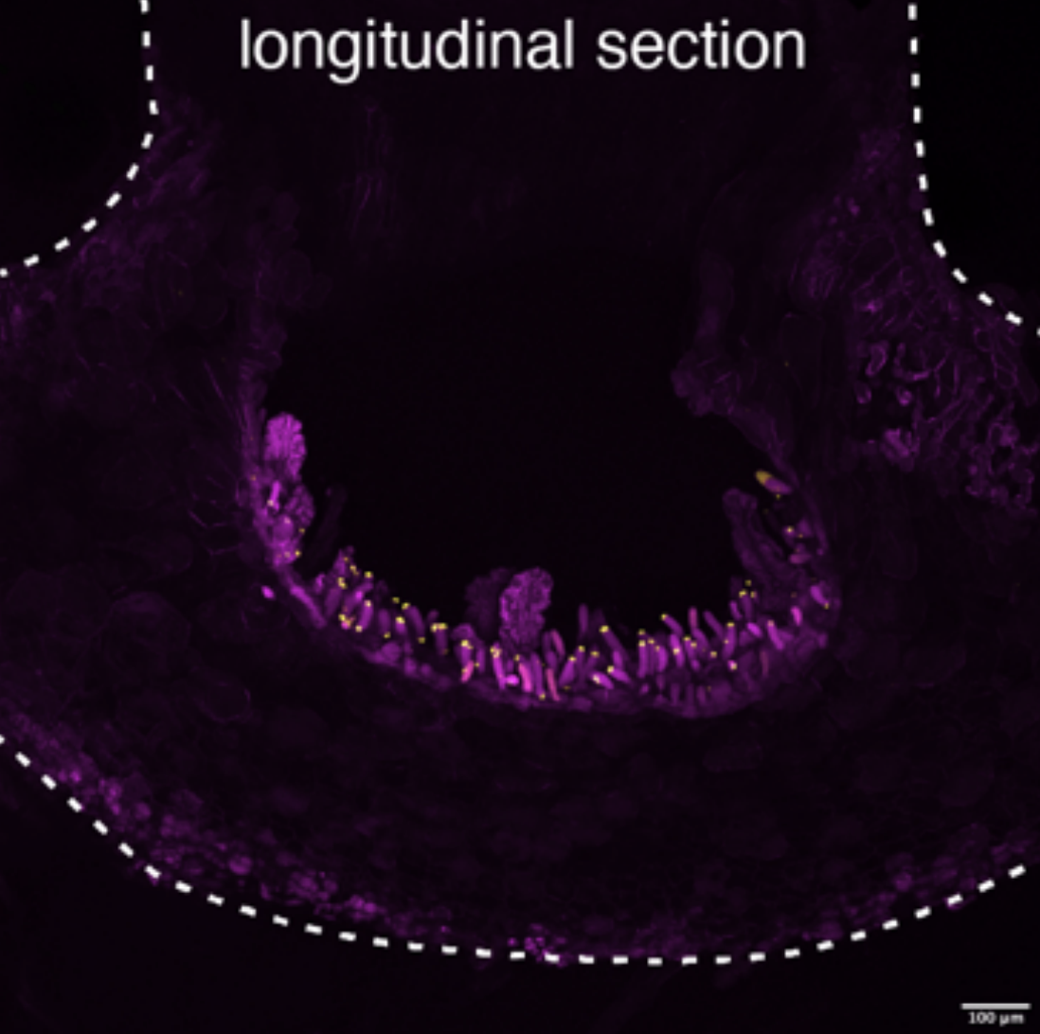
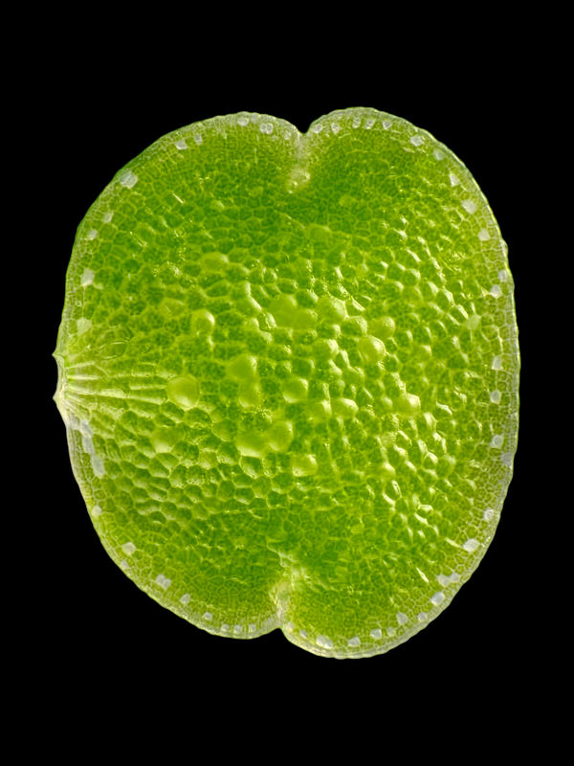
Notch
Stalk cells
Central portion
Notch

Slide 13
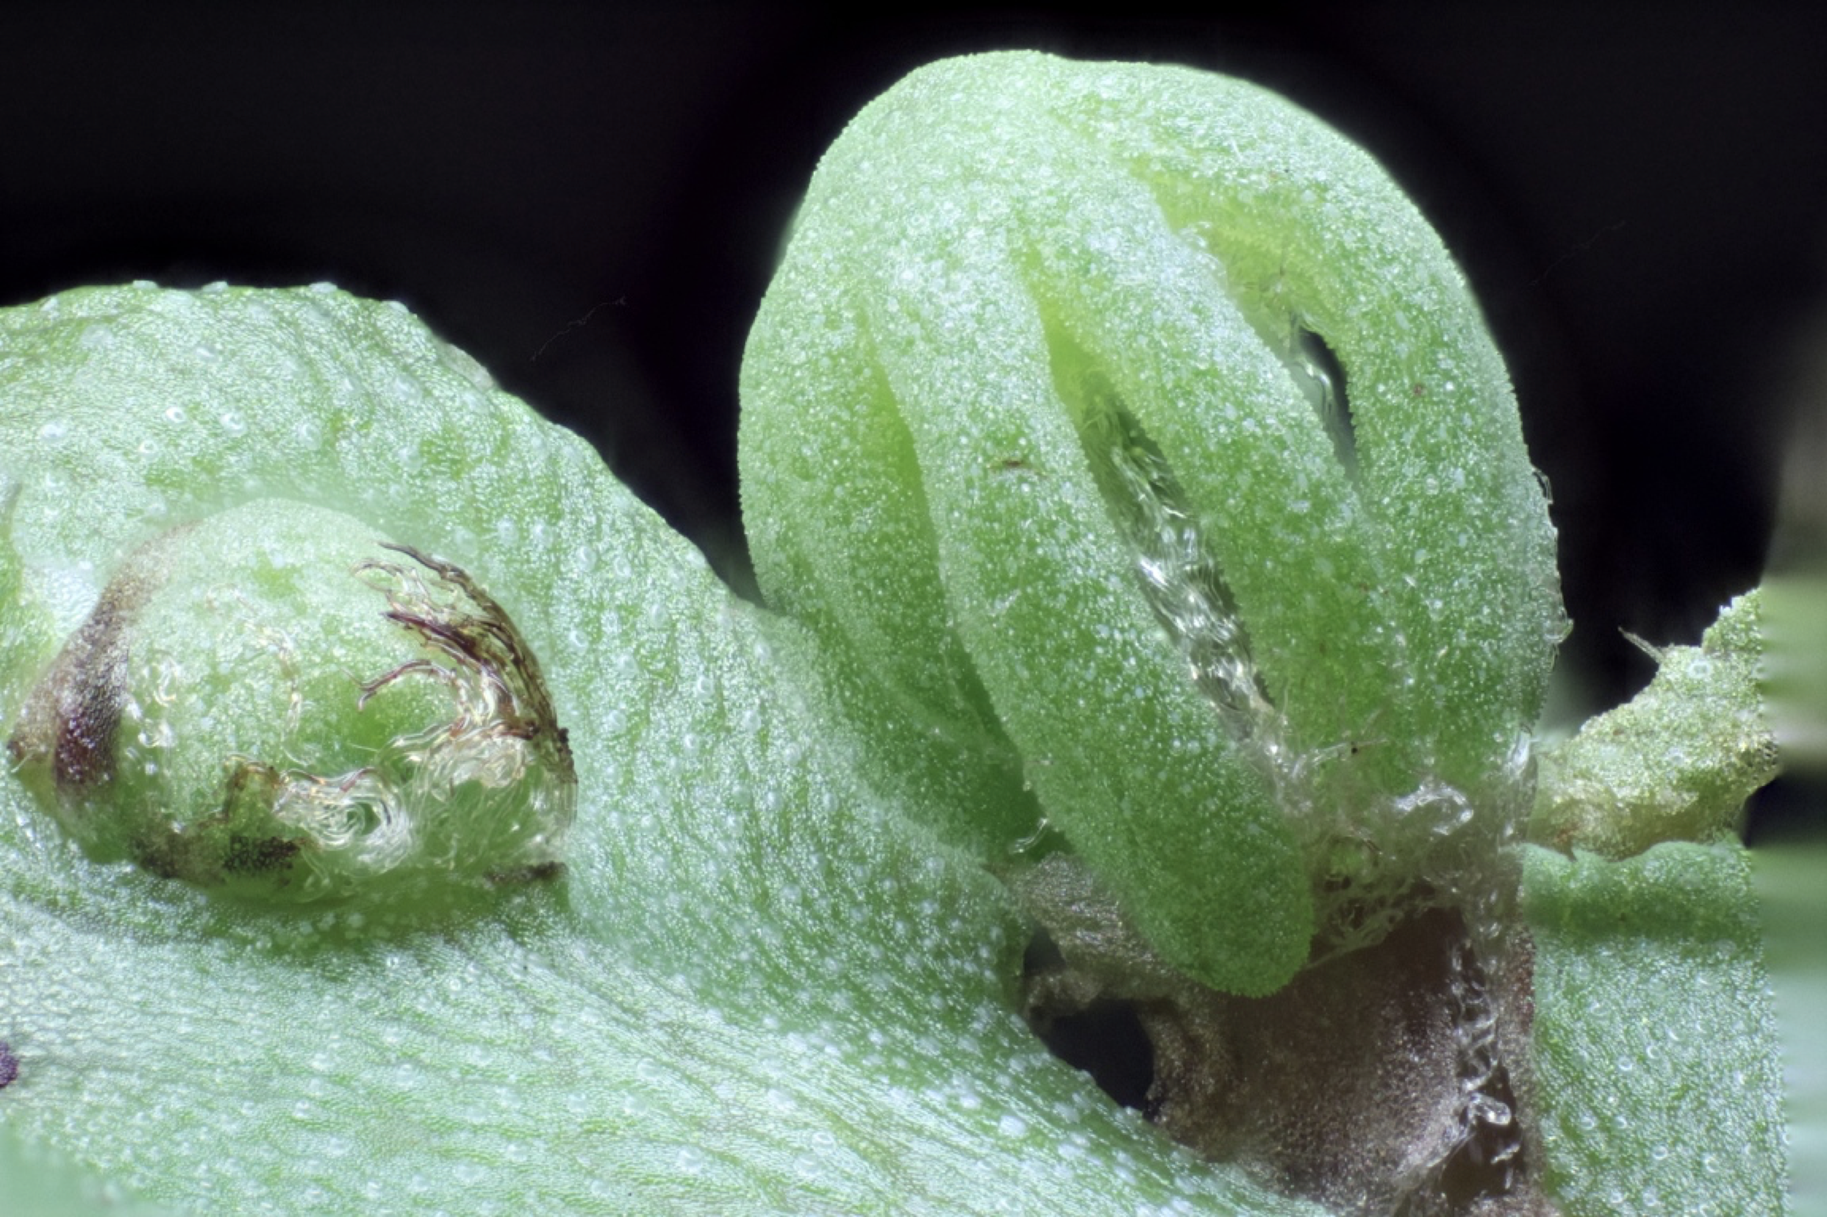
Marchantia polymorpha subsp. ruderalis – anatomy and morphology
Marchantia, like all land plants, goes through a diploid stage in life
Supplementation with far red light causes gametangiophores to develop from meristematic notches
This transition is not very well understood anatomically
Male plants produce antheridiophores
Female plants produce archegoniophores
These structures are still haploid
Very young archegoniophore emerging from a female plant

Slide 14
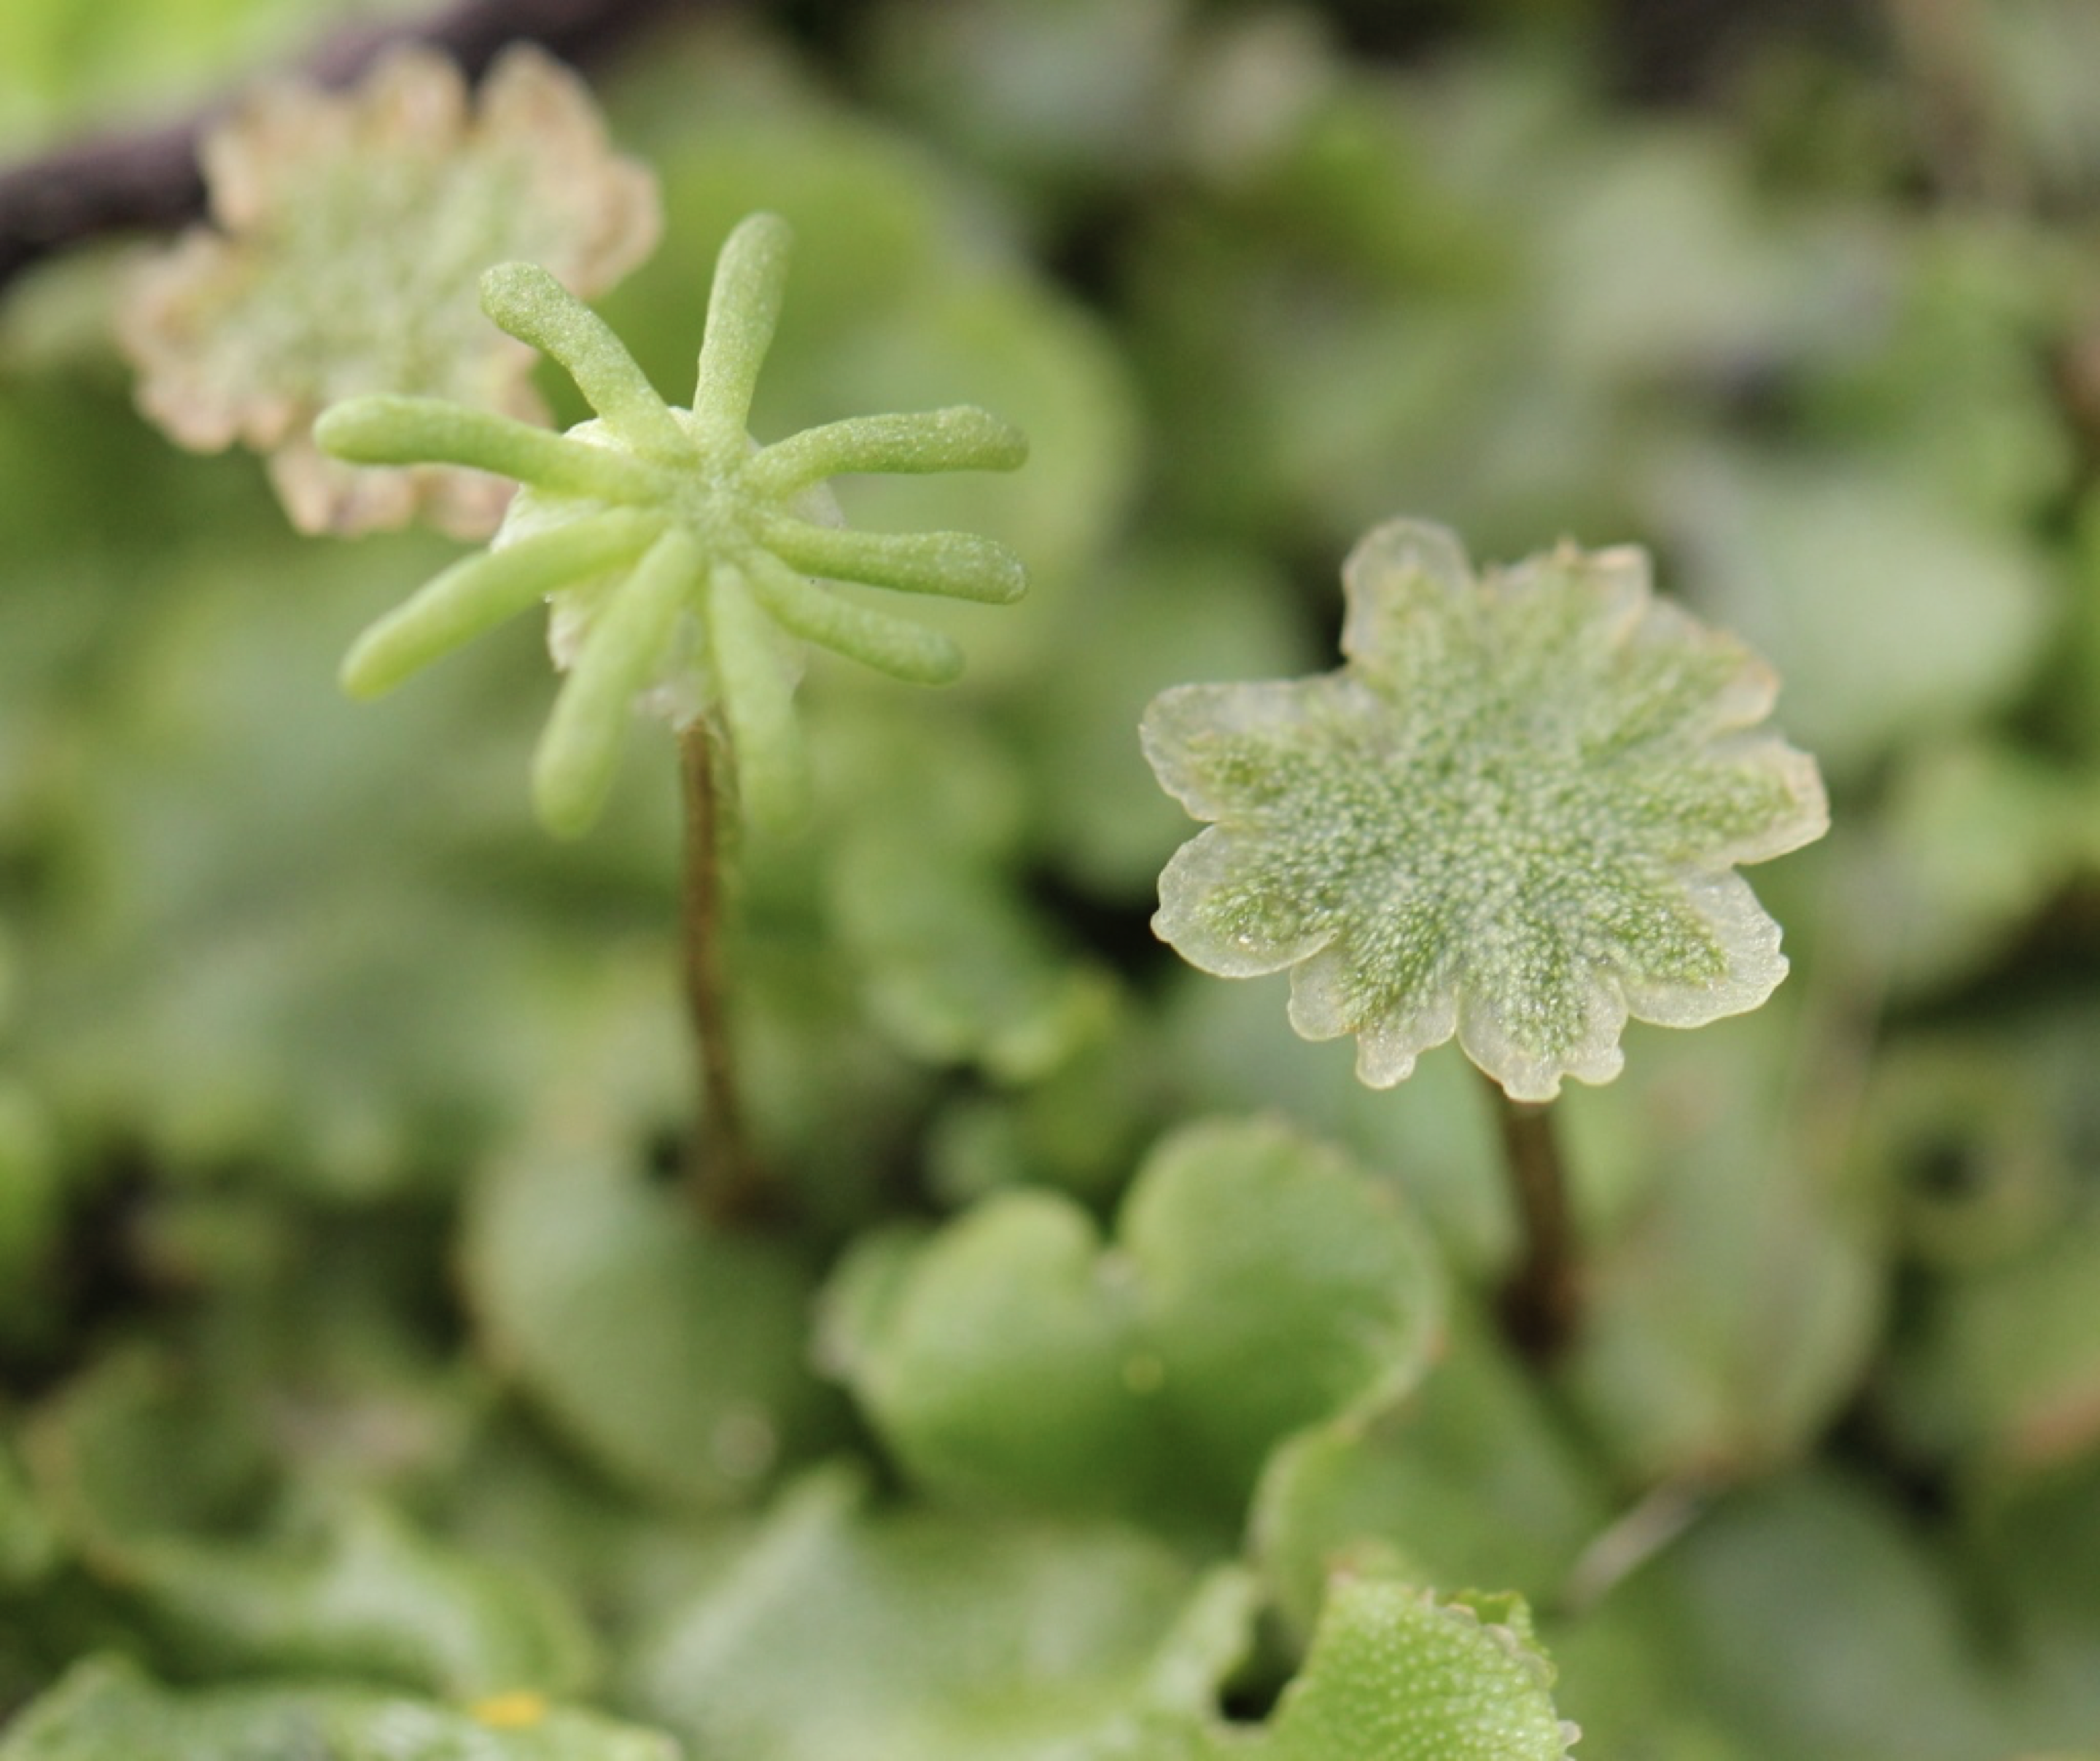
Archegoniophore
Archegonia are located on the ventral side of finger-like projections
Archegonia are surrounded by pseudoperianth tissue
Antheridiophore
Antheridia are located dorsally and release sperm cells when they come in contact with water droplets
Sperm cells are motile and can be pipetted onto archegoniophores

Slide 15
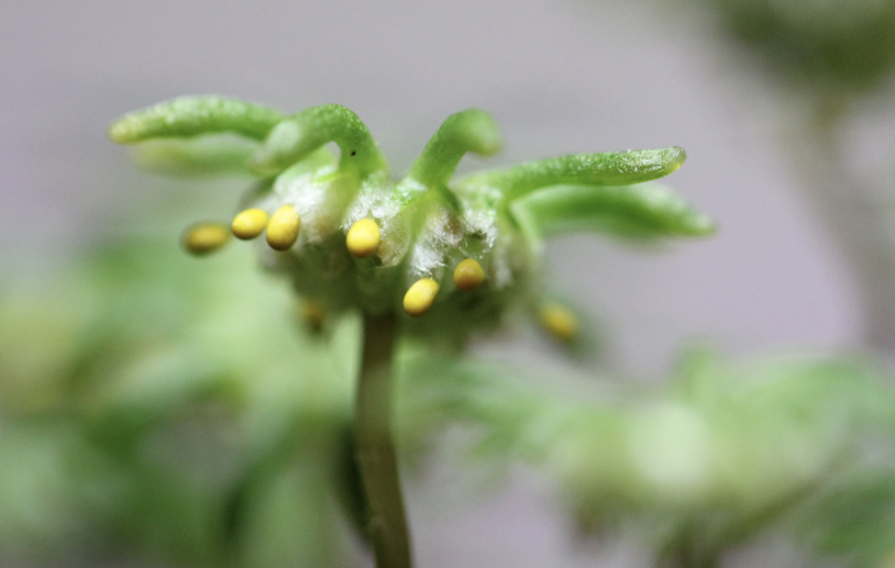
Marchantia polymorpha subsp. ruderalis – anatomy and morphology
1n
1n
Calyptra and pseudoperianth covering the sporophyte
Stalk
Not actually a stalk sensu angiosperms
Highly modified thallus wrapped around a bundle of rhizoids
Sporophyte
Foot
Seta (reduced in Marchantia)
capsule
2n but male genome silenced epigenetically
Archegoniophore with yellow sporophytes

Slide 16
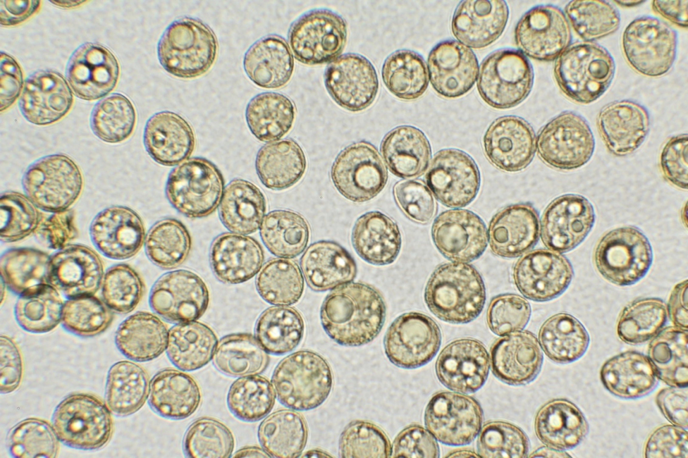
Marchantia polymorpha subsp. ruderalis – anatomy and morphology
Single cell spores

Slide 17
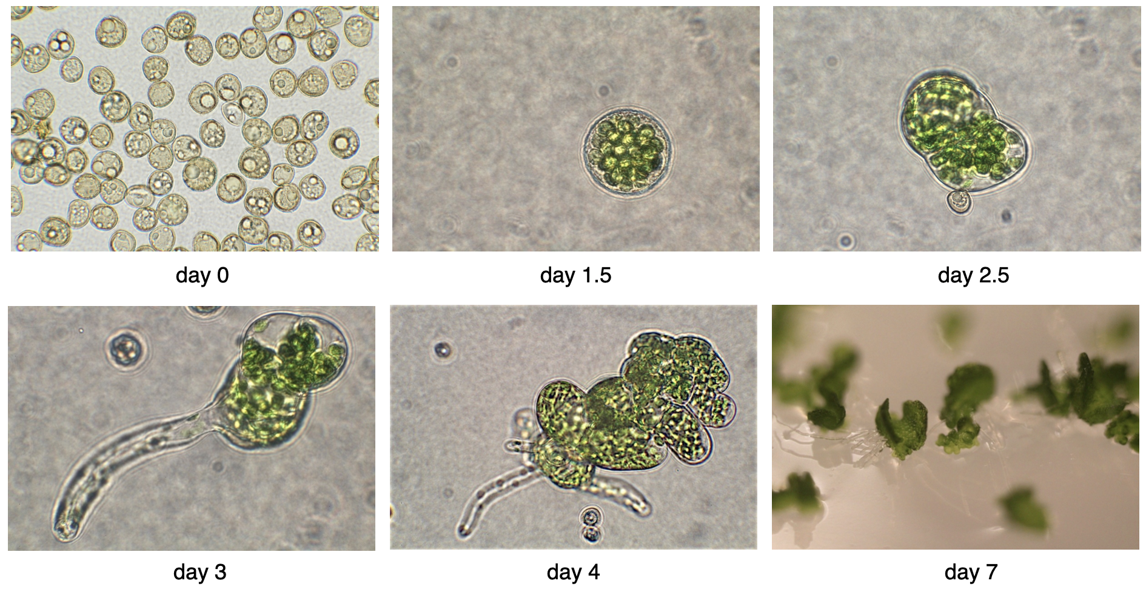
Marchantia polymorpha subsp. ruderalis – anatomy and morphology
Spore germination

Slide 18
How do we work with it?
Marchantia polymorpha subsp. ruderalis – methods
Marchantia can be propagated in three different ways
By cutting thallus into pieces – they do not have to contain meristems to make new plants, any size fragment will work (down to one microdissected epidermal cell)
By going through the full life cycle – 2-3 months. This is easier in Cam lines compared to Tak lines
By using gemmae

Slide 19
All of those can be used to transform the plant with agrobacterium
Marchantia polymorpha subsp. ruderalis – methods
Cut pieces of 2-week-old plants can be incubated with agrobacterium to produce transformants (low throughput)
A single archegoniophore with sporangia can be used to transform tens of constructs into sporelings
Gemmae transformation is not routinely used in most research grups but is possible, follows cut thallus transformation protocol

Slide 20
Marchantia is haploid
Marchantia polymorpha subsp. ruderalis – methods
Transformants emerge after a week and can be screened for fluorescence
They are haploid, no need to worry about heterozygosity
CRISPR/Cas9 works reliably to produce mutants – usually you need to genotype ±50 plants (one round of transformants)
Homologous recombination is a rare event and requires screening of hundreds of plants and large homology regions (thousands of base pairs)

Slide 21
Technical notes
Marchantia polymorpha subsp. ruderalis – methods
Large (10kbp+) T-DNAs often don’t incorporate fully. Use fluorescent markers at 5’ end to screen for successful t-DNA transfer events
Supertransformation works well (G418, Hyg, Cs, more to come)
Transformation with mixed agrobacteria works well (10-fold loss in efficiency)
Biolistic transformation works well
Transient agrobacterium transformation does not work reliably (single cells transfected) (2023)

